Slide 1

Chapter 2 – Software Processes
Chapter 2 Software Processes

Slide 2
Topics covered
Software process models
Process activities
Coping with change
The Rational Unified Process
An example of a modern software process.
Chapter 2 Software Processes

Slide 3
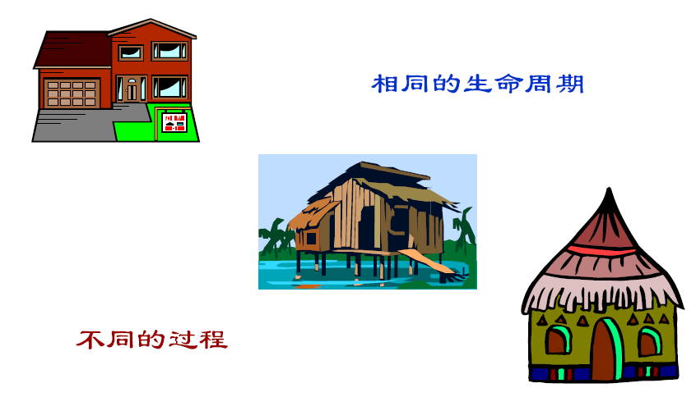
Different process of building the houses
The same life cycle
Different processes

Slide 4
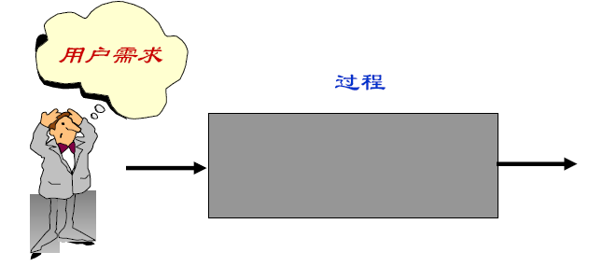
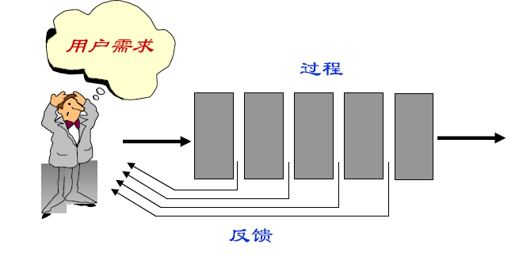
Two modes for producing software
Process
Software
The invisible process
Process
Software
A visible Process
Feedback

Slide 5
The software process
A structured set of activities required to develop a software system.
Many different software processes but all involve:
Specification – defining what the system should do;
Design and implementation – defining the organization of the system and implementing the system;
Validation – checking that it does what the customer wants;
Evolution – changing the system in response to changing customer needs.
A software process model is an abstract representation of a process. It presents a description of a process from some particular perspective.
Chapter 2 Software Processes

Slide 6
Software process descriptions
When we describe and discuss processes, we usually talk about the activities in these processes such as specifying a data model, designing a user interface, etc. and the ordering of these activities.
Process descriptions may also include:
Products, which are the outcomes of a process activity;
Roles, which reflect the responsibilities of the people involved in the process;
Pre- and post-conditions, which are statements that are true before and after a process activity has been enacted or a product produced.
Chapter 2 Software Processes

Slide 7
Plan-driven and agile processes
Plan-driven processes are processes where all of the process activities are planned in advance and progress is measured against this plan.
In agile processes, planning is incremental and it is easier to change the process to reflect changing customer requirements.
In practice, most practical processes include elements of both plan-driven and agile approaches.
There are no right or wrong software processes.
Chapter 2 Software Processes

Slide 8
Software process models
The waterfall model
Plan-driven model. Separate and distinct phases of specification and development.
Incremental development
Specification, development and validation are interleaved. May be plan-driven or agile.
Reuse-oriented software engineering
The system is assembled from existing components. May be plan-driven or agile.
In practice, most large systems are developed using a process that incorporates elements from all of these models.
Chapter 2 Software Processes

Slide 9
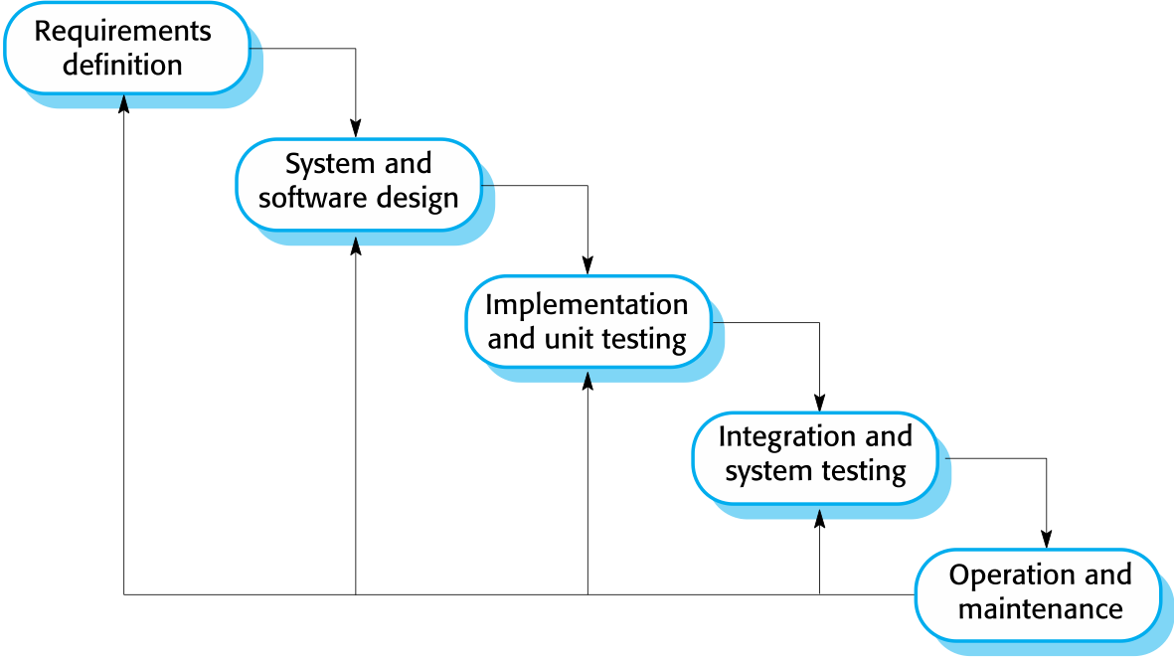
The waterfall model
Chapter 2 Software Processes

Slide 10
Waterfall model phases
There are separate identified phases in the waterfall model:
Requirements analysis and definition
System and software design
Implementation and unit testing
Integration and system testing
Operation and maintenance
The main drawback of the waterfall model is the difficulty of accommodating change after the process is underway. In principle, a phase has to be complete before moving onto the next phase.
Chapter 2 Software Processes

Slide 11
Waterfall model problems
Inflexible partitioning of the project into distinct stages makes it difficult to respond to changing customer requirements.
Therefore, this model is only appropriate when the requirements are well-understood and changes will be fairly limited during the design process.
Few business systems have stable requirements.
The waterfall model is mostly used for large systems engineering projects where a system is developed at several sites.
In those circumstances, the plan-driven nature of the waterfall model helps coordinate the work.
Chapter 2 Software Processes

Slide 12
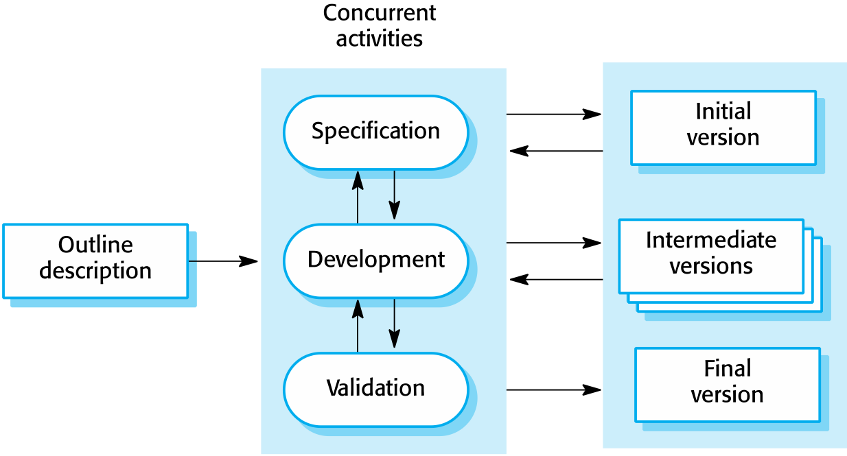
Incremental development
Chapter 2 Software Processes

Slide 13
Incremental development benefits
The cost of accommodating changing customer requirements is reduced.
The amount of analysis and documentation that has to be redone is much less than is required with the waterfall model.
It is easier to get customer feedback on the development work that has been done.
Customers can comment on demonstrations of the software and see how much has been implemented.
More rapid delivery and deployment of useful software to the customer is possible.
Customers are able to use and gain value from the software earlier than is possible with a waterfall process.
Chapter 2 Software Processes

Slide 14
Incremental development problems
The process is not visible.
Managers need regular deliverables to measure progress. If systems are developed quickly, it is not cost-effective to produce documents that reflect every version of the system.
System structure tends to degrade as new increments are added.
Unless time and money is spent on refactoring to improve the software, regular change tends to corrupt its structure. Incorporating further software changes becomes increasingly difficult and costly.
Chapter 2 Software Processes

Slide 15
Reuse-oriented software engineering
Based on systematic reuse where systems are integrated from existing components or COTS (Commercial-off-the-shelf) systems.
Process stages
Component analysis;
Requirements modification;
System design with reuse;
Development and integration.
Reuse is now the standard approach for building many types of business system
Reuse covered in more depth in Chapter 16.
Chapter 2 Software Processes

Slide 16
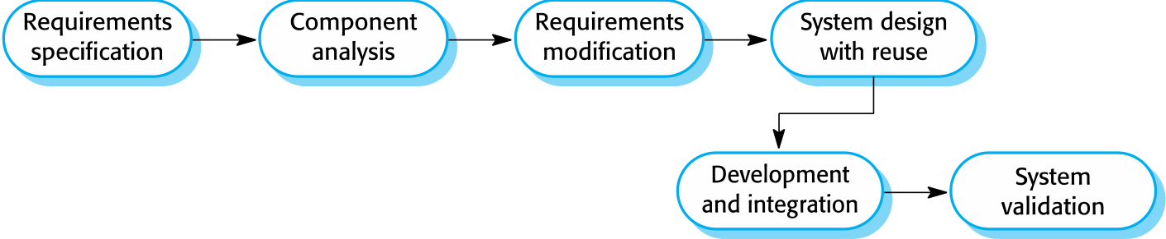
Reuse-oriented software engineering
Chapter 2 Software Processes

Slide 17
Types of software component
Web services that are developed according to service standards and which are available for remote invocation.
Collections of objects that are developed as a package to be integrated with a component framework such as .NET or J2EE.
Stand-alone software systems (COTS) that are configured for use in a particular environment.
Chapter 2 Software Processes

Slide 18
Process activities
Real software processes are inter-leaved sequences of technical, collaborative and managerial activities with the overall goal of specifying, designing, implementing and testing a software system.
The four basic process activities of specification, development, validation and evolution are organized differently in different development processes. In the waterfall model, they are organized in sequence, whereas in incremental development they are inter-leaved.
Chapter 2 Software Processes

Slide 19
Software specification
The process of establishing what services are required and the constraints on the system’s operation and development.
Requirements engineering process
Feasibility study
Is it technically and financially feasible to build the system?
Requirements elicitation and analysis
What do the system stakeholders require or expect from the system?
Requirements specification
Defining the requirements in detail
Requirements validation
Checking the validity of the requirements
Chapter 2 Software Processes

Slide 20
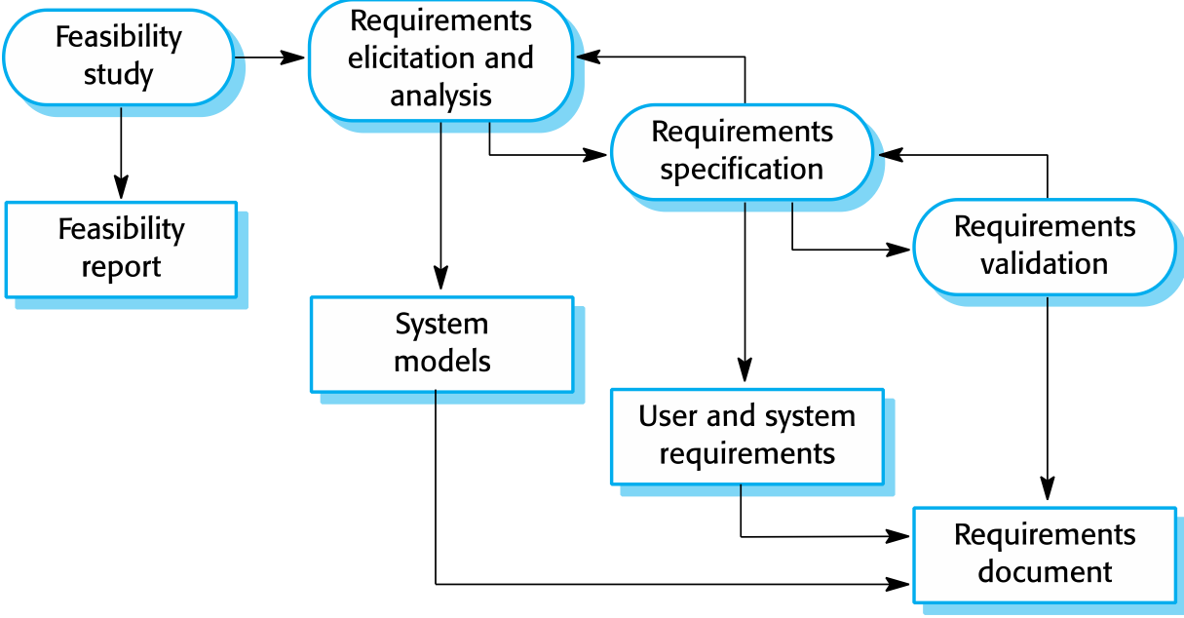
The requirements engineering process
Chapter 2 Software Processes

Slide 21
Software design and implementation
The process of converting the system specification into an executable system.
Software design
Design a software structure that realises the specification;
Implementation
Translate this structure into an executable program;
The activities of design and implementation are closely related and may be inter-leaved.
Chapter 2 Software Processes

Slide 22
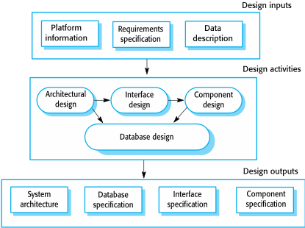
A general model of the design process
Chapter 2 Software Processes

Slide 23
Design activities
Architectural design, where you identify the overall structure of the system, the principal components (sometimes called sub-systems or modules), their relationships and how they are distributed.
Interface design, where you define the interfaces between system components.
Component design, where you take each system component and design how it will operate.
Database design, where you design the system data structures and how these are to be represented in a database.
Chapter 2 Software Processes

Slide 24
Software validation
Verification and validation (V & V) is intended to show that a system conforms to its specification and meets the requirements of the system customer.
Involves checking and review processes and system testing.
System testing involves executing the system with test cases that are derived from the specification of the real data to be processed by the system.
Testing is the most commonly used V & V activity.
Chapter 2 Software Processes

Slide 25
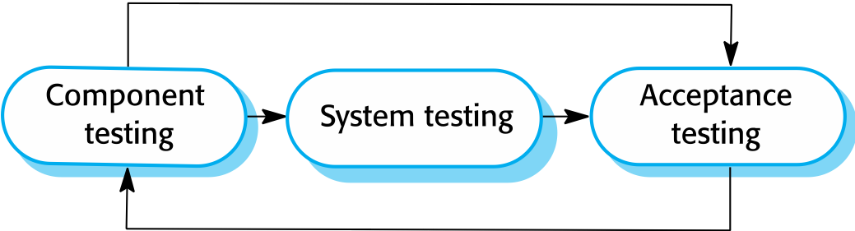
Stages of testing
Chapter 2 Software Processes

Slide 26
Testing stages
Development or component testing
Individual components are tested independently;
Components may be functions or objects or coherent groupings of these entities.
System testing
Testing of the system as a whole. Testing of emergent properties is particularly important.
Acceptance testing
Testing with customer data to check that the system meets the customer’s needs.
Chapter 2 Software Processes

Slide 27
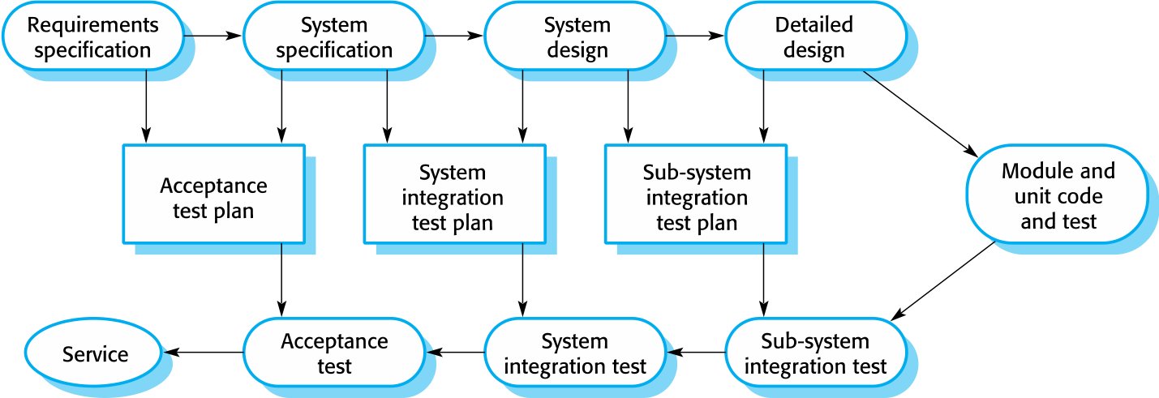
Testing phases in a plan-driven software process
Chapter 2 Software Processes

Slide 28
Software evolution
Software is inherently flexible and can change.
As requirements change through changing business circumstances, the software that supports the business must also evolve and change.
Although there has been a demarcation between development and evolution (maintenance) this is increasingly irrelevant as fewer and fewer systems are completely new.
Chapter 2 Software Processes
Notes:
demarcation ：分界线

Slide 29
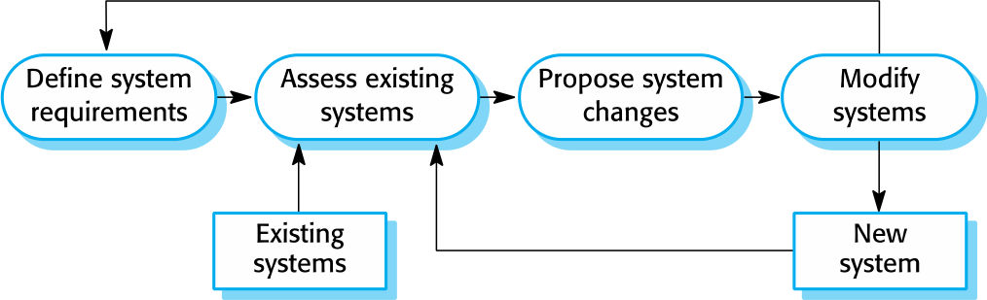
System evolution
Chapter 2 Software Processes

